Slide 1


FEE-CS186
Faculty Name:
Lavish Arora
ETE PROJECT :
(E - commerce website) Name: Ananya Seth
Roll No: 2110990176
Group no: 05

Slide 2

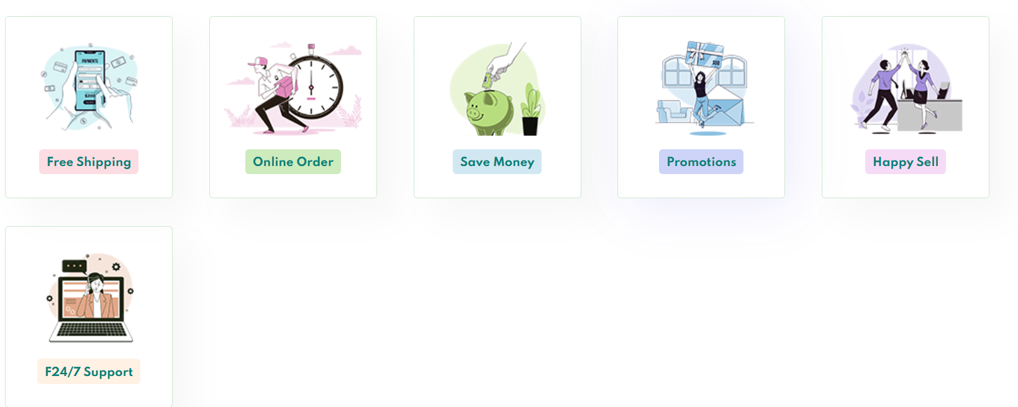
Cara
"Front-End Development: Enhancing User Experiences for e-commerce website with HTML, CSS, JavaScript."
This project represents a culmination of my efforts to explore and apply front-end technologies to create impactful user experiences.

Slide 3

LOGIN
Navbar
CART
NAVIGATION BAR
REACT ROUTER

Slide 4
Website description
1. Product Card :
- Leveraging techniques to display product cards that adapt to user interactions.
2. Product Pages:
- Employing the same principles to create product pages that respond to user engagement.
3. Integrated Cart Functionality with Javascript:
- Seamlessly integrating shopping cart

Slide 5
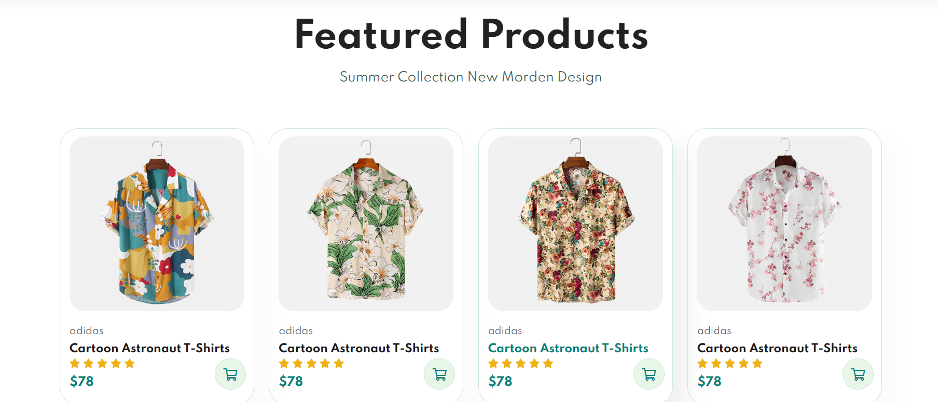
New Section

Slide 6
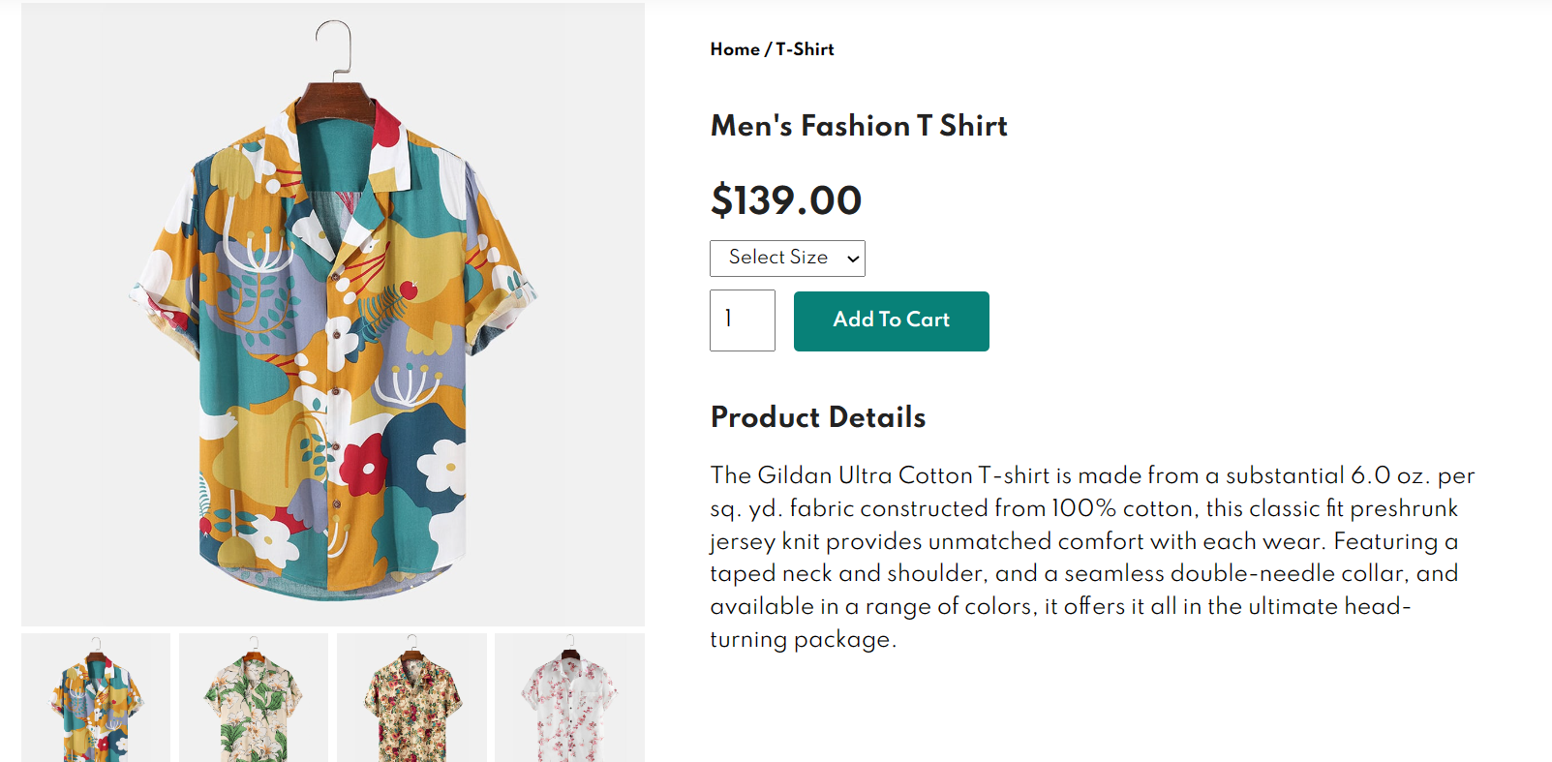
DYNAMICALLY RENDERED
PRODUCT PAGE

Slide 7
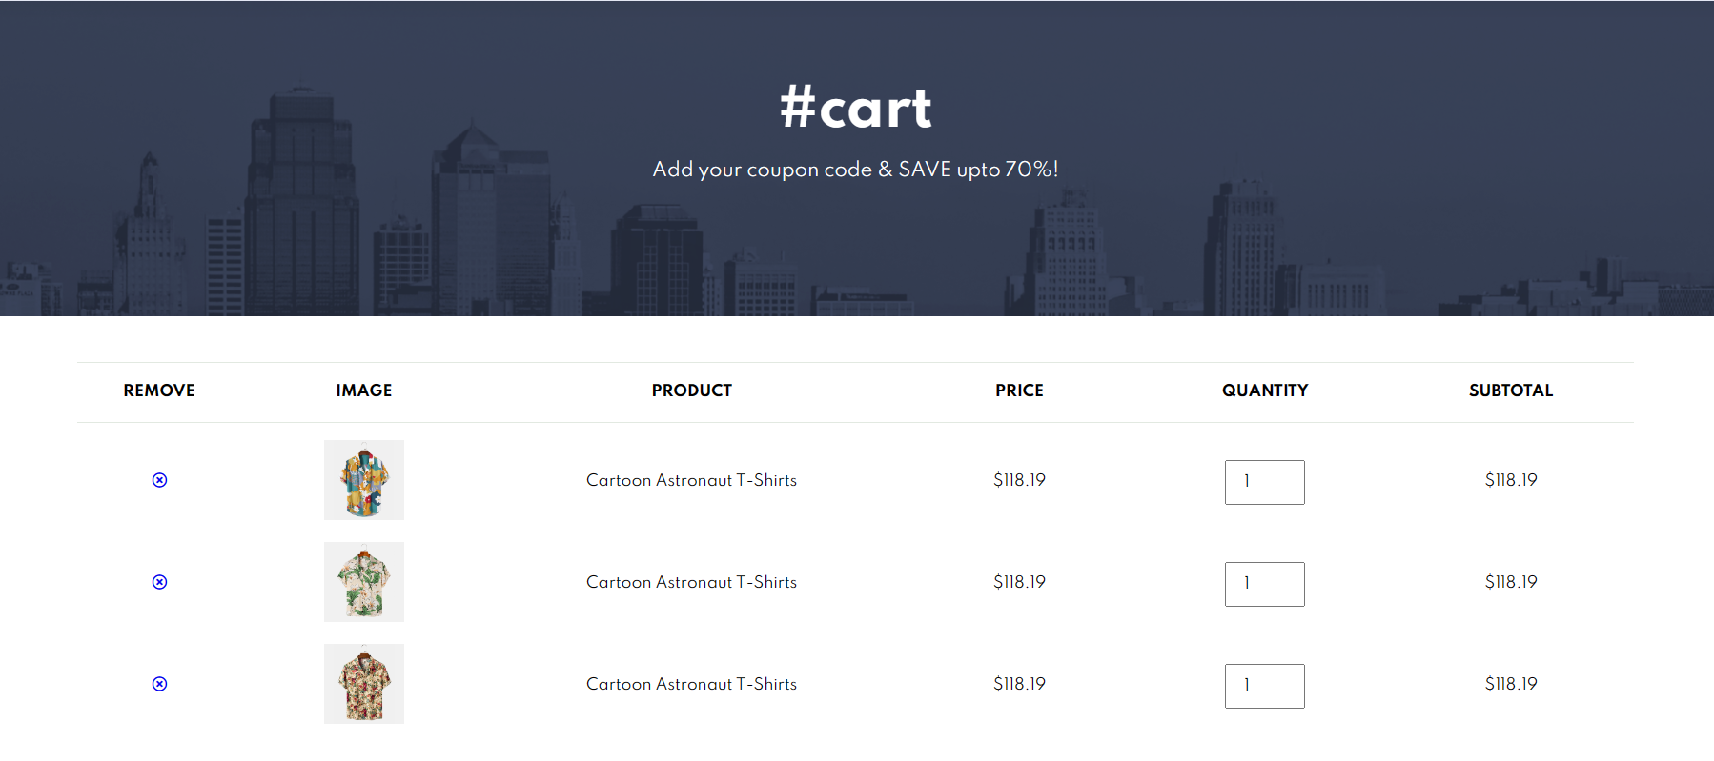
Items will add
Cart:Items will add with on clicking the +

Slide 8
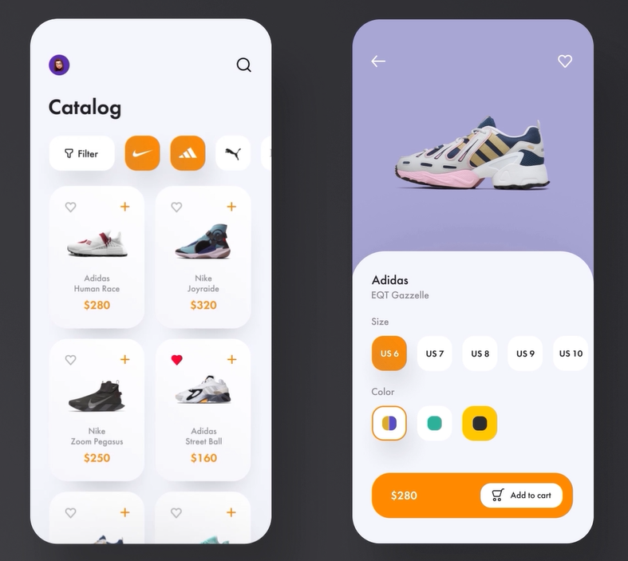
Added video using video tag :
In Demo page

Slide 9
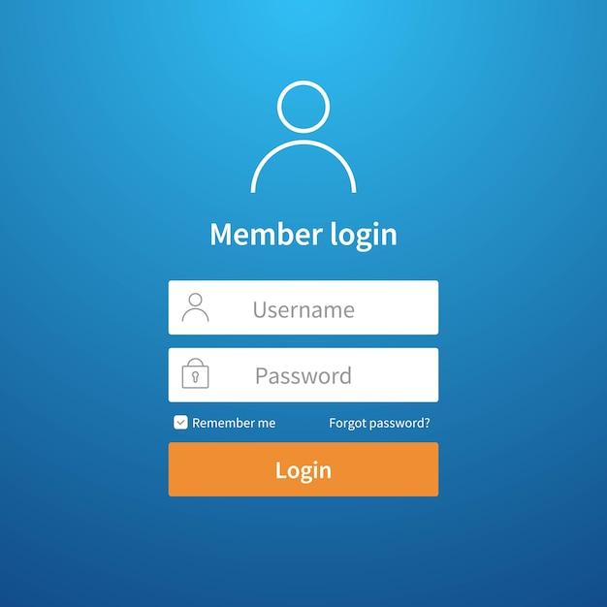
SIGNUP / LOGIN PAGE

Slide 10
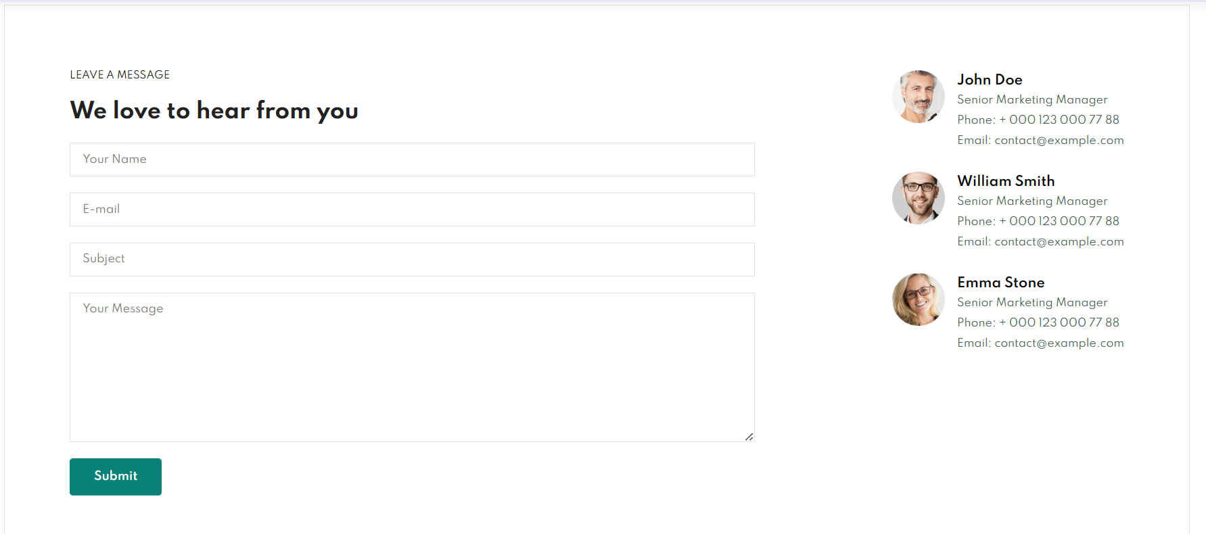
CONTACT US PAGE
Contact Us

Slide 11
THANK YOU

